Slide 1



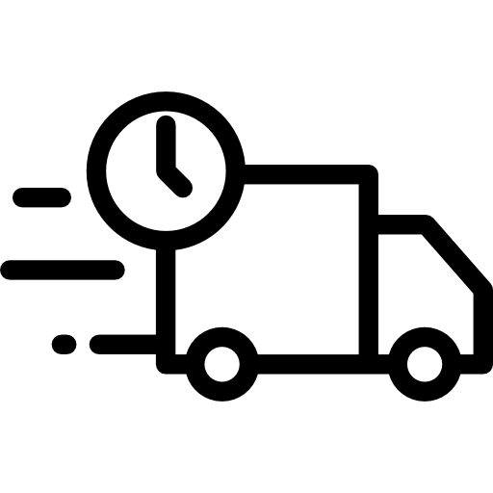


PCS OVERVIEW FLOW
Customer
Sale
Production Main Line
Production Sub Line
Purchase
Supplier
Order
Import Order
(RO)
MRP Purchase
MRP Production
Compare Order and Shipment data
Purchase Plan
Delivery Note
Production Plan
Purchase Request (PR)
Input Shipment
Work Order / Inspection
Production Tag
Purchase Request (PO)
Purchase Tag
Delivery Sheet
Shipment Tag
Purchase Received
Invoice
Work Result
Shipment Result
(-) FG
Handy
Production Result
(+) FG
Production Result
(-) Material
Purchase Received
(+) Material
Stock OUT
Stock
(Warehouse)
Stock IN
Stock OUT
Stock IN

